Slide 1
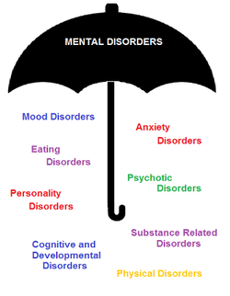
TYPES OF PSYCHOLOGICAL DISORDERS

Slide 2
PSYCHOLOGICAL DISORDERS
ANXIETY DISORDER
SOMATOFORM DISORDER
DISSOCIATIVE DISORDER
SCIZOPHRENIC DISORDER
MOOD DISORDER
BEHAVIOURAL AND DEVELOPMENTAL DISORDER
SUBSTANCE DISORDER

Slide 3
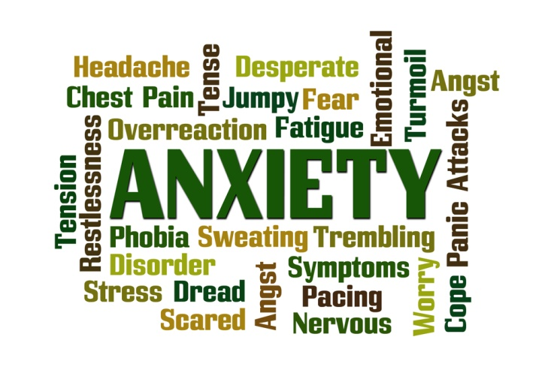

Slide 4
WHAT IS ANXIETY???
The term anxiety is usually defined as diffuse, vague, very unpleasant feeling of fear and apprehension.
Symptoms-
Rapid heart rate, loss of appetite, fainting, dizziness, sweating, sleeplessness, frequent urination and tremors.

Slide 5
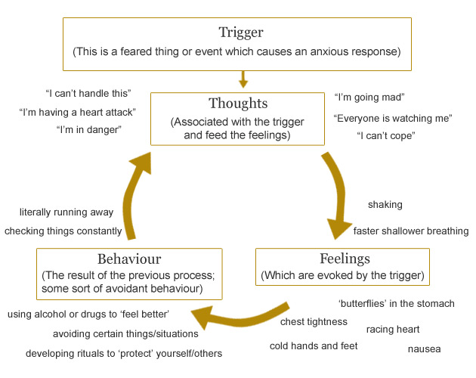

Slide 6
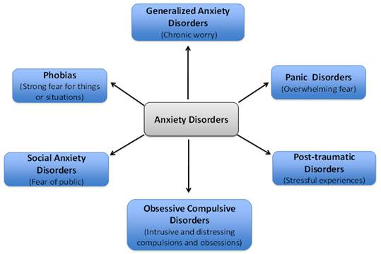

Slide 7
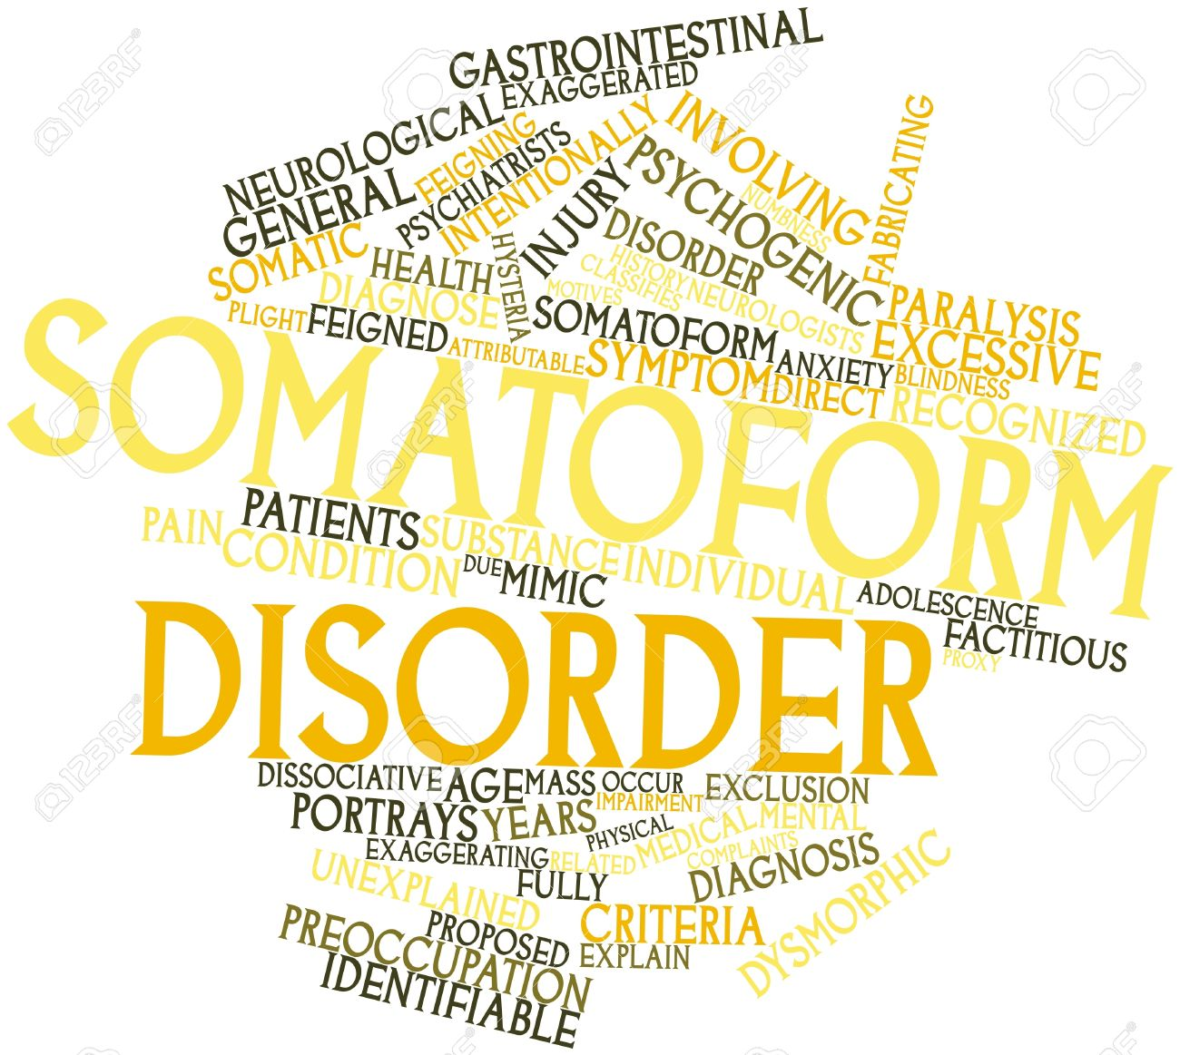

Slide 8
SOMATOFORM DISORDER
These are the conditions where there are physical symptoms in the absence of physical disease.
In this the individual has psychological difficulties and complains of physical symptoms for which there are no biological cause.
There are four types of somatoform disorders.

Slide 9
TYPES OF SOMATORM DISORDER
PAIN DISORDER involves reports of extreme and incapacitating pain.
SOMATISATION DISORDER involves multiple and chronic bodily complaints in a dramatic and exaggerated way.
The symptoms of CONVERSION DISORDER are the reported loss of part or all of some body functions.
HYPOCHONDRIASIS DISORDER is diagnosed if a person has a persistent belief that s/he has a serious illness without any physical symptoms

Slide 10
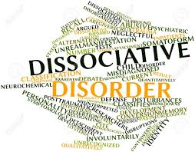

Slide 11
DISSOCIATIVE DISORDER
It involves feelings of unreality, estrangement, depersonalisation and sometimes a loss or shift of identity.
Sudden temporary alterations of consciousness that blots out painful experiences are a defining characteristics of dissociative disorders.

Slide 12
TYPES OF DISSOCIATIVE DISORDERS
DISSOCIATIVE AMNESIA is characterised by extensive but selective memory loss that has no organic cause.
DISSOCIATIVE FUGUE an unexpected travel away from home and work place, the assumption of new identity and unable to recall previous identity.
DISSOCIATIVE IDENTITY DISORDER person assumes alternate personalities.
DEPERSONALISATION involves dreamlike state, change of self perception.

Slide 13
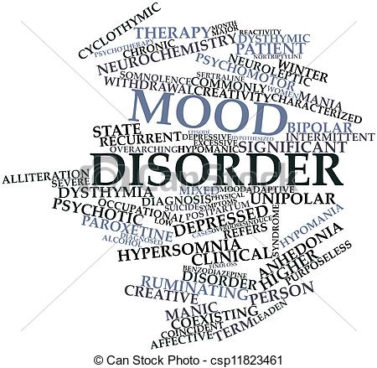

Slide 14
MOOD DISORDER
Mood disorders are characterised by disturbances in mood or prolonged emotional state.
Types of mood disorder-
Depression
Mania
Bipolar mood disorder
Risk of a suicide attempt

Slide 15
Major depressive disorder is defined as period of depressed mood and /or loss of interest or pleasure in most activities.
Symptoms- change in body weight, constant sleep problems, tiredness, inability to think clearly, agitation, slowed behaviour and thoughts of death and suicide.
People suffering from Mania are euphoric extremely active, talkative and easily distractible.
In some cases both mania and depression are alternately present this is known as Bipolar mood disorder.

Slide 16


Slide 17
SCHIZOPHRENIC DISORDER
It is the descriptive term for a group of psychotic disorders in which personal, social and occupational functioning deteriorate as a result of disturbed thought processes, strange perceptions, unusual emotional states and motor abnormalities.
The symptoms can be divided into –
positive, negative and psychomotor

Slide 18
Positive symptoms include excesses of thoughts, emotions and behaviour.
It includes-
a) delusions
b) hallucinations
c) formal thoughts disorders
d) inappropriate affect
Negative symptoms include-
a) alogia
b) blunted affect and flat affect
c) avolition

Slide 19
Psychomotor symptoms includes extreme forms known as catatonia.
Types of catatonia-
a) catatonic stupor
b) catatonic rigidity
c) catatonic posturing

Slide 20
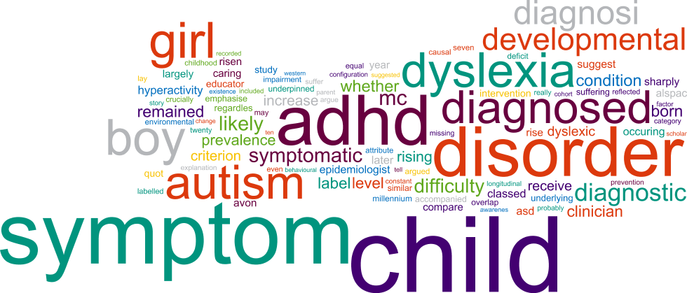

Slide 21
BEHAVIOURAL AND DEVELOPMENTAL DISODER
There are certain disorders that are specific to children.
Children have less self understanding and unstable sense of identity as a result there are unable to cope with stressful events which might be reflected in behavioural and emotional problems.
Achenbach has identified two factors-
Externalising disorder
Internalising disorder

Slide 22
Internalising
ADHD &
ODD
Conduct disorder & antisocial behaviour
Externalising
Separation anxiety disorder
Depression

Slide 23
Pervasive developmental disorder
Autism
Eating disorder
Anorexia Nervosa
Bulimia Nervosa
Binge Eating

Slide 24
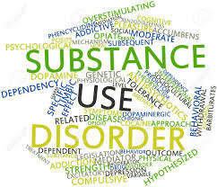

Slide 25
SUBSTANCE USE DISORDER
Addictive behaviour involves excessive intake of high calorie food resulting in extreme obesity or involving the abuse of substance such as alcohol , cocaine.
There are two sub groups –
1) substance dependence
2) substance abuse

Slide 26
THANK YOU….

